Slide 1

Day 2 Meeting with Carabao

Slide 2
Get in Touch with Carabao
Carabao is a MATLAB object class
Supports rapid prototyping of a GUI (so called “shell“)
Allows: to import log data, analyze & data
Rapid creation of reports
Data is contained in properties of objects
Objects can be stored to a data base & retrieved from there
Objects can be copied and pasted into „packages“
Objects can be selected from a package by „basket concept“
You can generate overview graphics or KPI-numbers over the objects of a basket (subset of a package)

Slide 3

Rapid Prototyping
Carabao is an object class that supports rapid protyping.
Making an espresso takes less than 30 seconds.
Deriving a new object class from Carabao takes less than 30 seconds

Slide 4

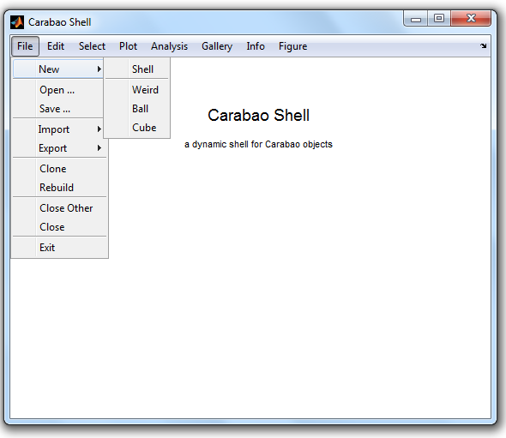
Launching a Carabao Shell
Mind: have a Carabao class folder on the MATLAB path (e.g. Carabao/v1e)

Slide 5
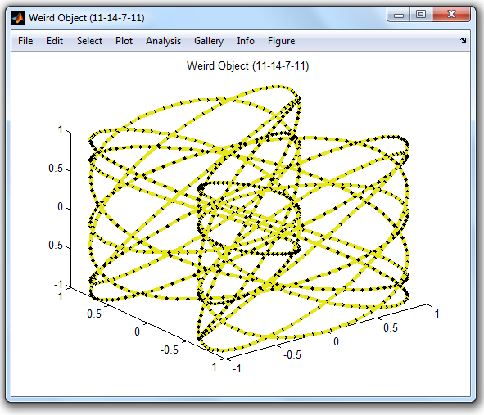
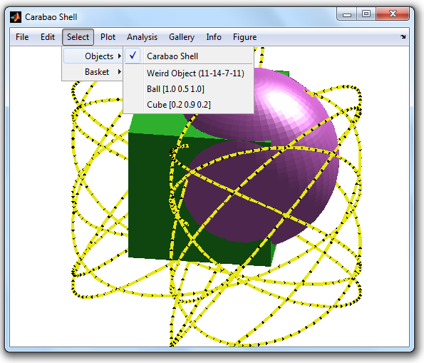
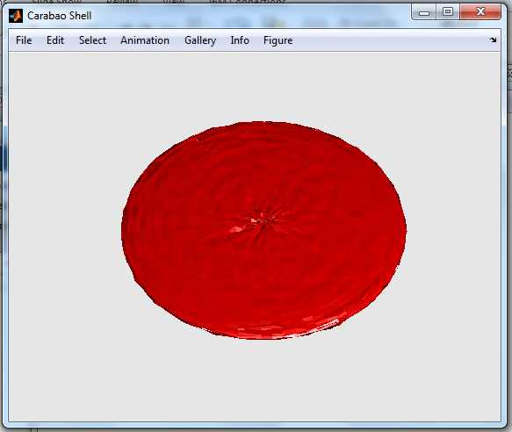
Weird, Ball, Cube & Shit Objects
A Carabao shell can hold several objects which can be of different class and type
To demonstrate this we are using
weird objects (class ‘carabao‘, type ‘weird‘)
ball objects (class ‘carabao‘, type ‘ball‘)
cube objects (class ‘carabao‘, type ‘cube‘)
shit objects (class ‘carashit‘, type ‚‘shell‘)

Slide 6
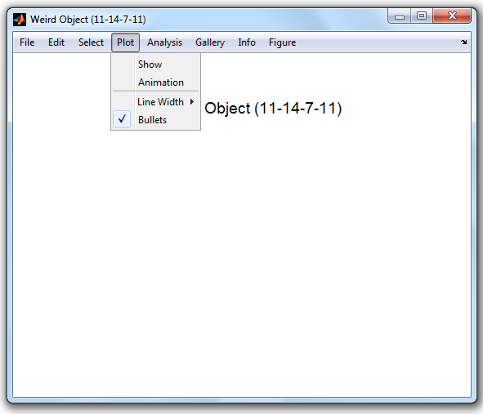
A Weird Object
Create a weird object for playing around
Click: File>New>Weird

Slide 7
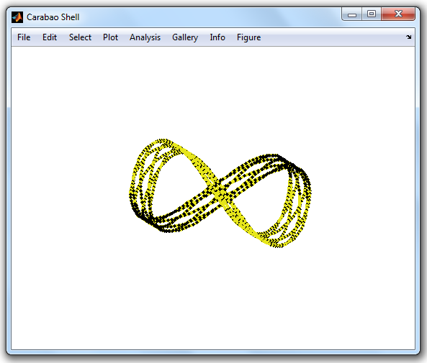
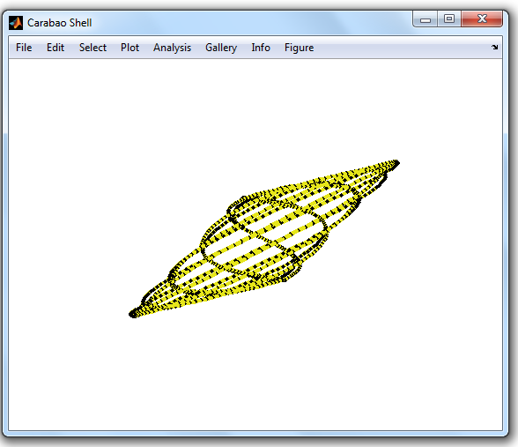
Plotting & Animating
We can show and animate the weird object
Click: Plot>Show or Plot>Animate

Slide 8
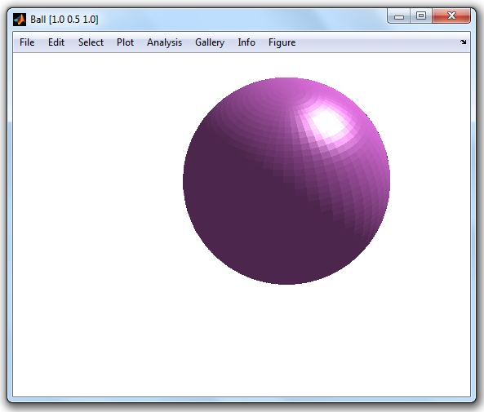
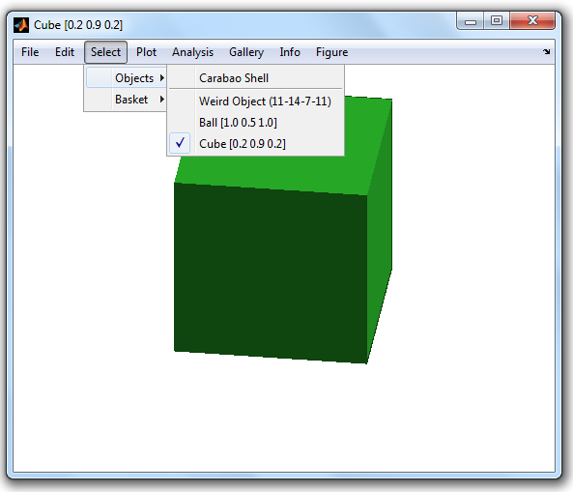
Ball & Cube Objects
Creating other objects like balls and cubes
Click: File>New>Ball and File>New>Cube

Slide 9
Selecting an Object
Select an object using the Select/Objects menu
Selecting the package object (Carabao Shell) we see all objects

Slide 10
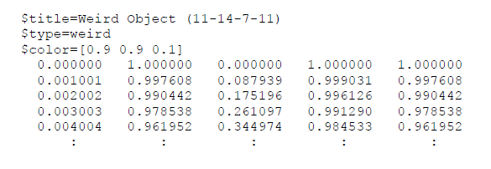
Exporting an Object
Select weird object: Select>Objects>Weird Object (11-14-7-11)
Export object (to file weird object (11-14-7-11).txt )
Click File>Export>Text File (.txt)
Investigate exported file:

Slide 11
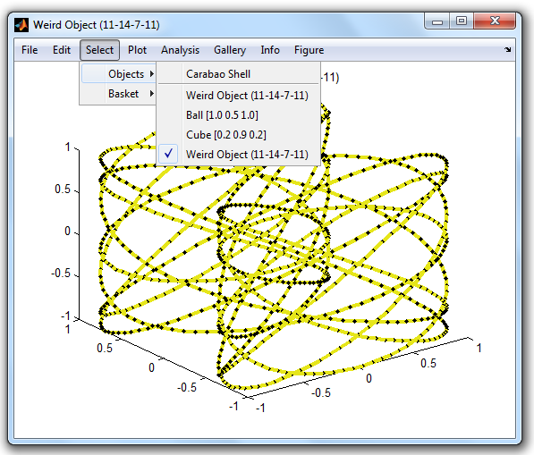
Import an Object
Import object (from file weird object (11-14-7-11).txt )
Click File>Import>Text File (.txt)
Check object list: Select>Objects
Show imported object: Plot>Show

Slide 12
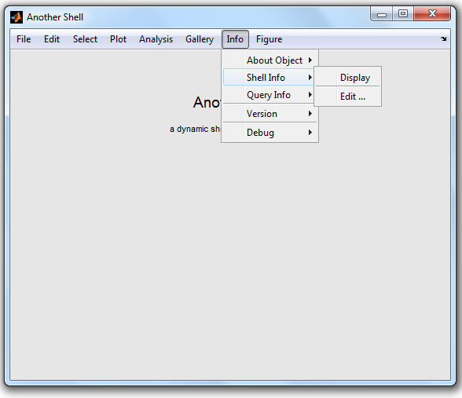
Launch Another Carabao Shell
Click File>NewShell
Change title (into “Another Shell“)
using Info>Shell Info>Edit ...

Slide 13
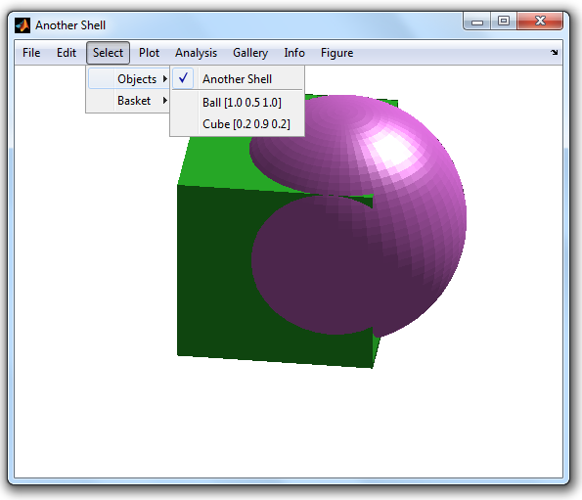
Copy & Paste Objects
Select an object using Select>Objects
Copy object: Edit>Copy
Paste object into “Another Shell“: Edit>Paste

Slide 14
Cutting & Clearing Objects
Select an object using Select>Objects
Cut object: Edit>Cut
Clear all objects of the shell: Edit>Clear

Slide 15
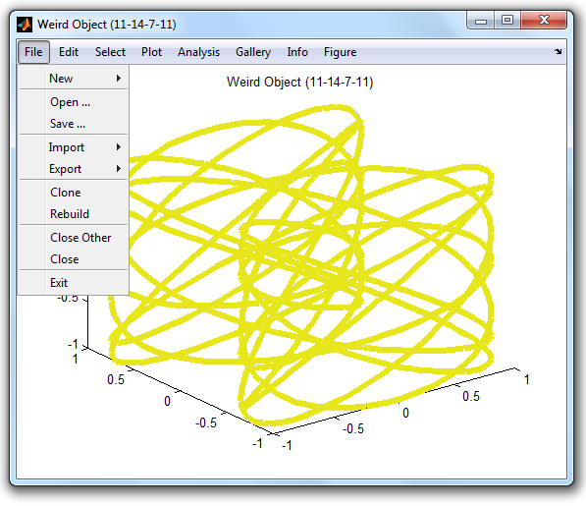
Saving & Loading the Shell
open a new Carabao shell and create a weird object
change some plot settings (disable bullets, change line width)
=> Plot>Bullets, Plot/Line With>5
save shell: File>Save ...
load shell: File>Open ... (all plot settings are restored)

Slide 16
Cloning a Shell
Either: save and load a shell
or: File>Clone ... (all plot settings and the current graphics are cloned)

Slide 17
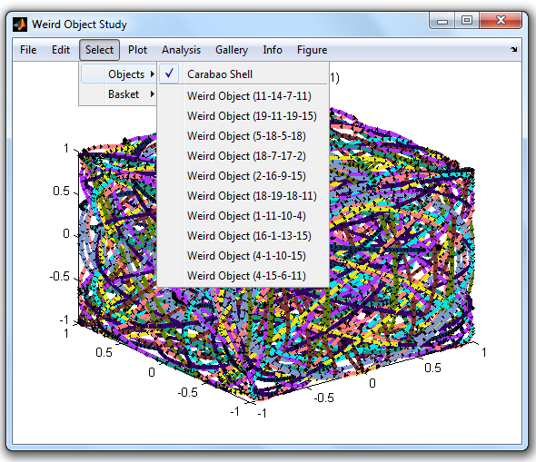
Cloning a Shell
Either: save and load a shell
or: File>Clone ... (all plot settings and the current graphics are cloned)

Slide 18
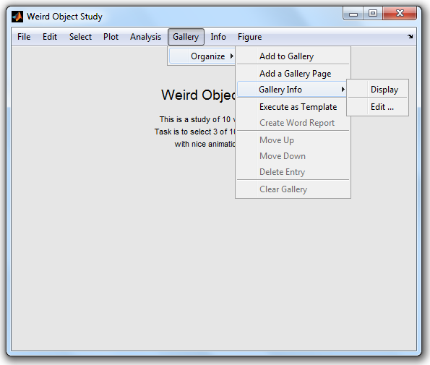
The Gallery
Can add any current graphics to the gallery
Recalling a gallery picture does also restore the according shell settings

Slide 19
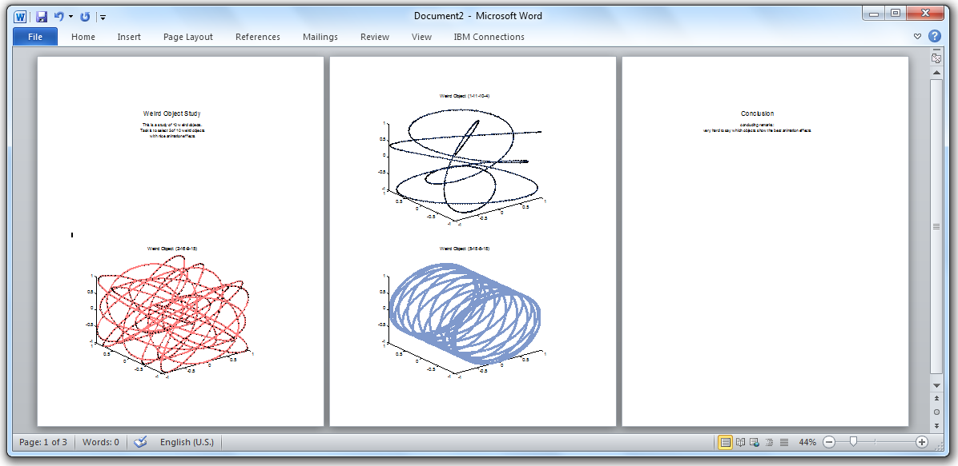
Report Generation
A Word report can be generated from the gallery

Slide 20

The Basket
The „basket“ is an abstract concept for defining a sub-collection of all shell objects.
By standard a selection by class and/or type is supported
The „basket“ method can be overloaded for customized applications

Slide 21

Break in Fresh Air

Slide 22
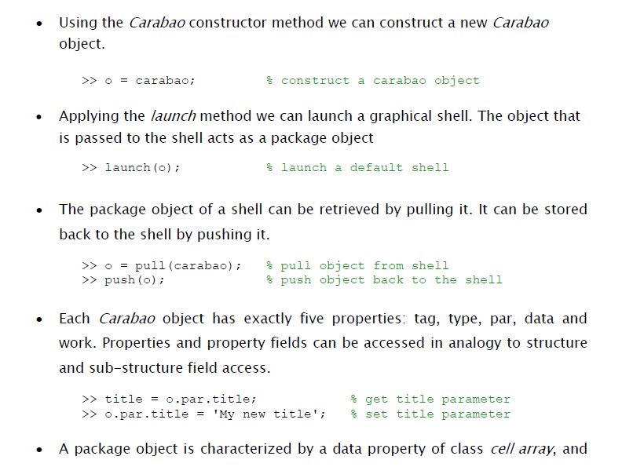
Lessons Learnt (1)

Slide 23
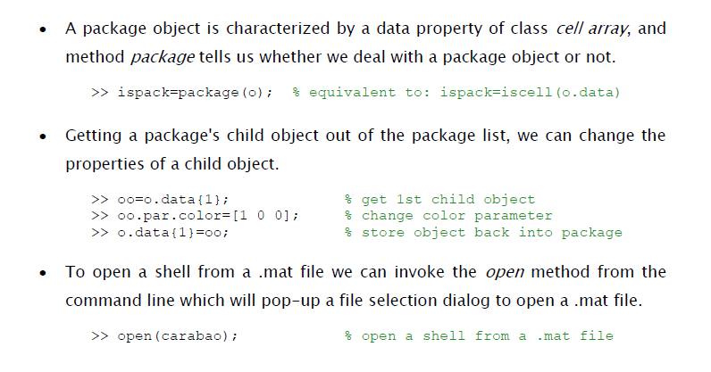
Lessons Learnt (2)

